Slide 1
Disaster Nationalism
Unnatural Disasters 2018

Slide 2
“Every one of Singapore's founding fathers began their political careers believing there was no such thing as a Singaporean and that Singapore couldn't possibly be independent. They all believed Singapore was a part of Malaya. They stumbled, tripped into their identities as Singaporeans.”
-Janadas Devan, Institute of Policy Studies, 2013

Slide 3
Nation as “imagined community”
“My point of departure is that nationality, or, as one might prefer to put it in view of that word’s multiple significations, nation-ness, as well as nationalism, are cultural artefacts of a particular kind.”
Benedict Anderson, Imagined Communities

Slide 4
“It is imagined because the members of even the smallest nation will never know most of their fellow-members, meet them, or even hear of them, yet in the minds of each lives the image of their communion.”

Slide 5
Key terms
Nation
Nation-state
‘sovereignty’ of the nation
Nationalism
An attitude toward the ‘nation’
Actions taken to seek to achieve (or sustain) self-determination

Slide 6
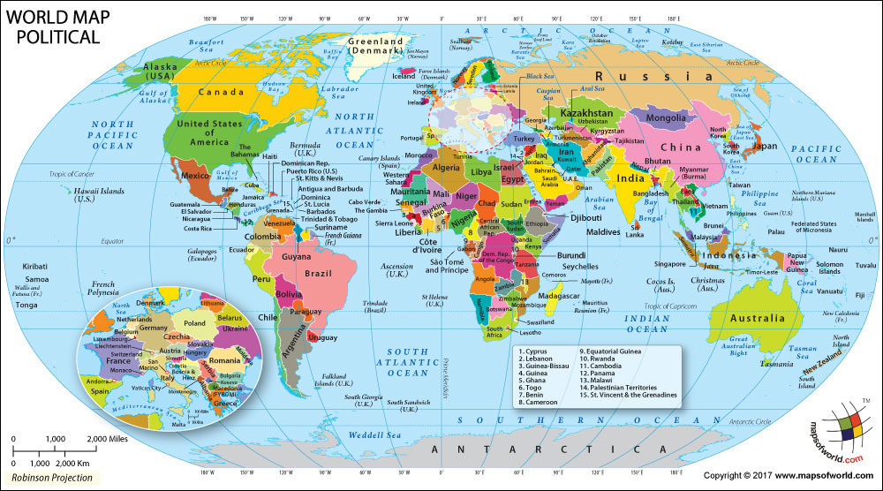
Nation-State

Slide 7
Disaster nationalism in Sri Lanka

Slide 8
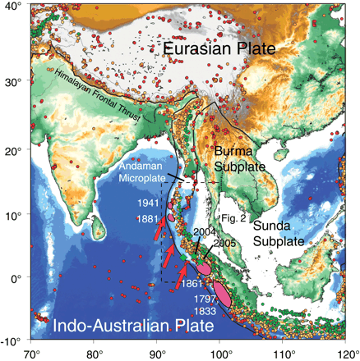
Notes:
Regional map showing earthquakes with magnitudes >5.0 from 1965 to 25 December 2004 from the earthquake catalog of the National Earthquake Information Center (NEIC). Red dots show events with depths <33 km; orange, depths of 33 to 70 km; yellow, depths of 70 to 105 km; and green, depths >105 km. Locations of previous large earthquake ruptures along the Sunda-Andaman trench system are shown in pink. Dashed box shows area of the map in Fig. 2. Green stars show the epicenters of the two recent great events; the green diamond shows the CMT centroid location for the 2004 Sumatra-Andaman event. The thick red arrows indicate the NUVEL-1 relative plate motions between the Indo-Australian and Eurasian plates.

Slide 9
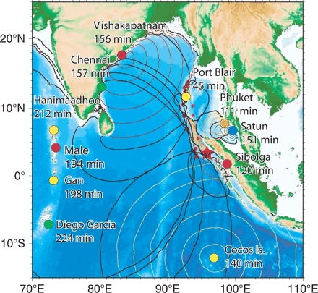
Notes:
Constraints on the tsunami source area obtained from the timing of tsunami arrivals at various locations around the Indian Ocean. Dark lines indicate the distance from the observing points from which tsunami might have generated at the event origin time. The tsunami source area outlined by these curves (brown region) appears to extend only 600 to 800 km north-northwest from the epicenter.

Slide 10
Disaster Risk Reduction
There is no such thing as a 'natural' disaster, only natural hazards.
Disaster Risk Reduction (DRR) aims to reduce the damage caused by natural hazards like earthquakes, floods, droughts and cyclones, through an ethic of prevention.
Source: United Nations Office for Disaster Risk Reduction
https://www.unisdr.org/who-we-are/what-is-drr

Slide 11
According to the author, what is troubling about the way Disaster Risk Reduction was used in Sri Lanka?

Slide 12
What is the ‘function’ of preparedness?
What is the function of the “logic of disaster risk management and control”?

Slide 13
The article describes many alternative anticipatory practices.
Each group: identify one of these ways of anticipating futures and compare it with the official preparedness programs.

Slide 14
How does the disaster change political systems or power relations?
What is this “opening”?

Slide 15
Disaster as a “political opening” (Choi 287)
Compare Sri Lanka and Aceh in the aftermath of the Indian Ocean Tsunami (2004)
Do you see the “political opening” as the same or different? Why?

Slide 16
What is ‘disaster nationalism’?

